Slide 1
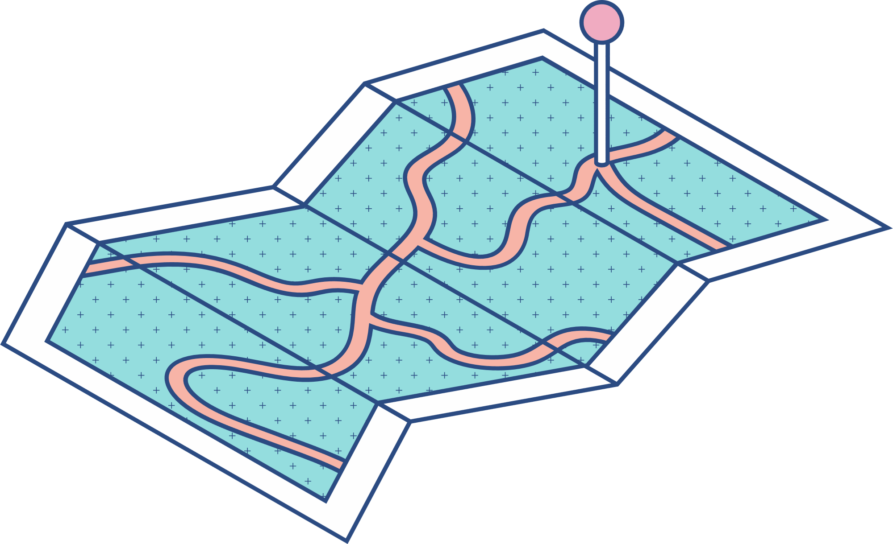





Asher A. Federico Jr.
Mini Project 1
Proposal
Samgyup sa Dagat

Slide 2
Project objectives
To develop an easy access website that enables costumer to visit and show them what to expect and experience on the place and foods offered.

Slide 3



Problem
The restaurant is located away from the city and people are way too unfamiliar with the place as well as with the food and services being offered.

Slide 4

Solution:
To promote and market samgyup sa dagat in Leyte
To provide information

Slide 5

Target Audience:
All gender
Resident in Leyte

Slide 6
Sitemap
SAMGYUP SA DAGAT
Homepage
Home
Menu
Gallery
About
Dash Board
Pork
Images
About Us
Chicken and Pork
Menu Highlight
Get in touch
Sides
Customer Reviews
Beverages

Slide 7
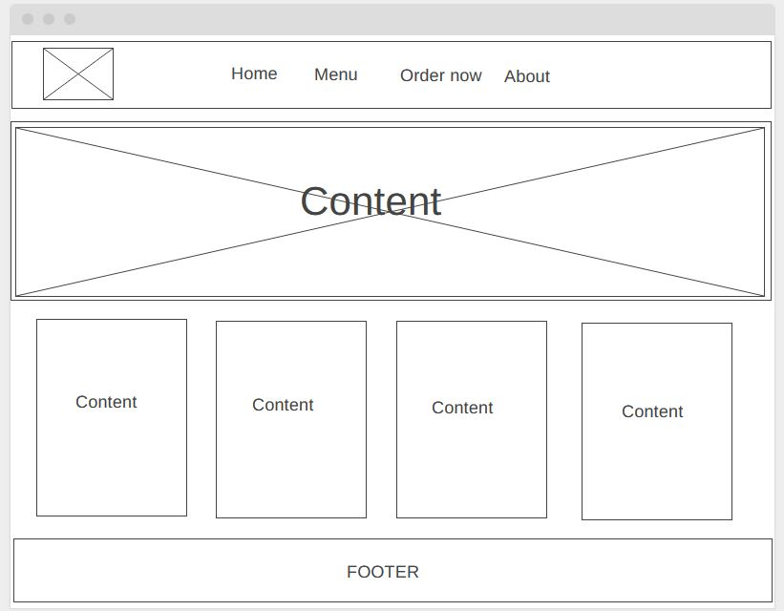
Wireframe

Slide 8

Thank you.

